Slide 1

Restaurant Automation System
Vincent Stevens, Adam Oswald, Tyler Yarow, Aarya Shah, and Amanvir Singh

Slide 2
Overview
Project Introduction
Most Appealing Features
Major Challenges and their Solutions
Lessons Learned/ Summary

Slide 3
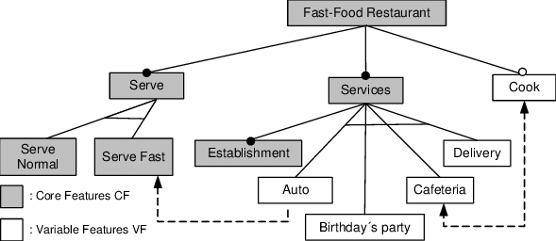
Project Introduction
Restaurants are fast-paced environments
Lots of moving pieces
Overhead
Payroll, ordering, scheduling, training, etc.
Optimization is the goal

Slide 4
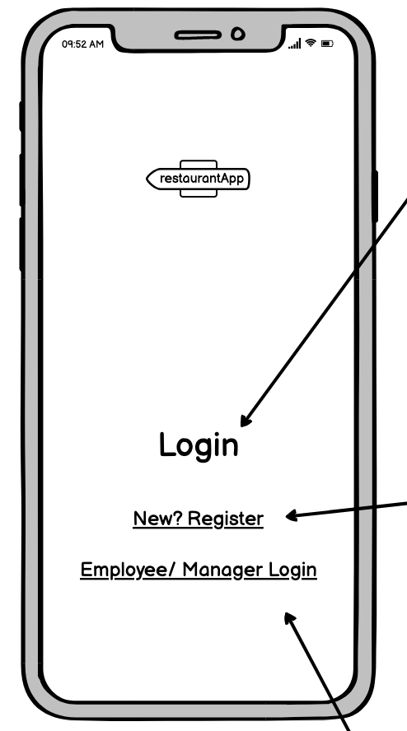
Most Appealing Features | Auth

Slide 5
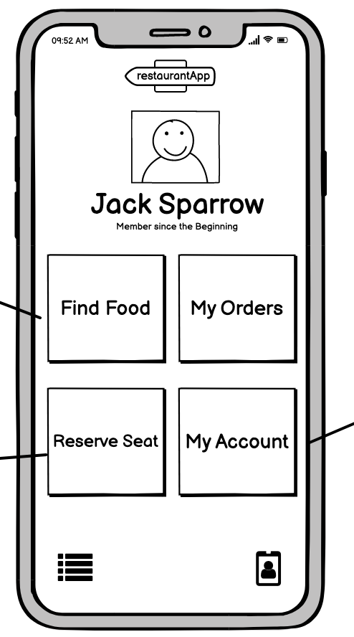
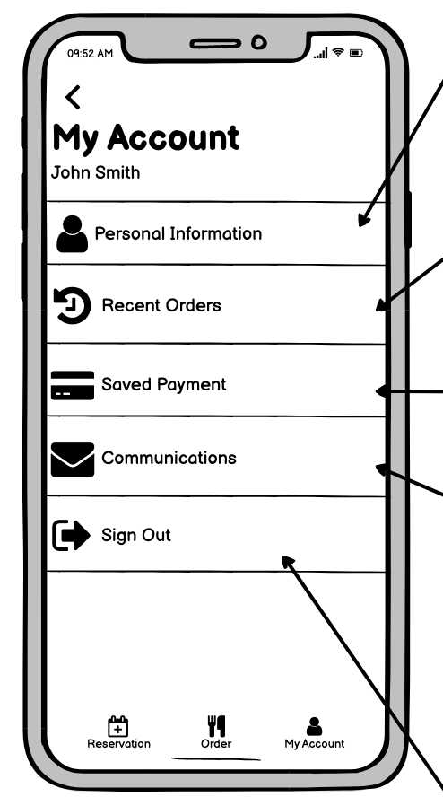
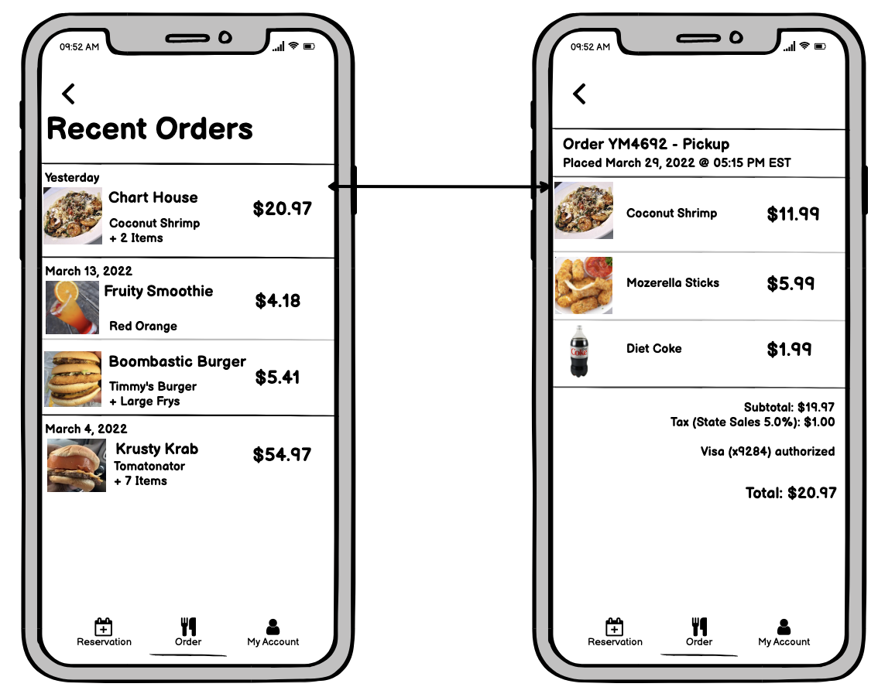
Most Appealing Features | Customer

Slide 6
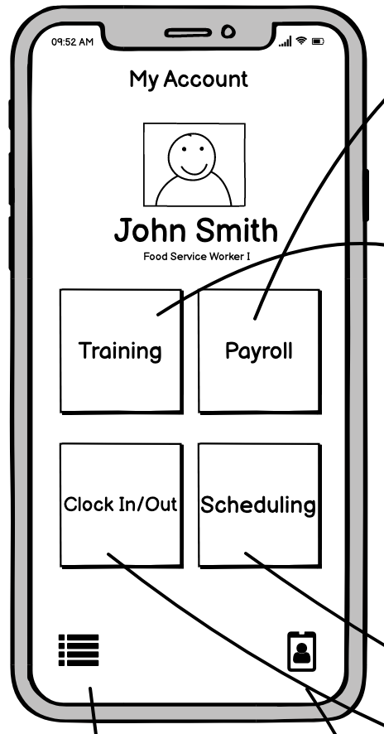
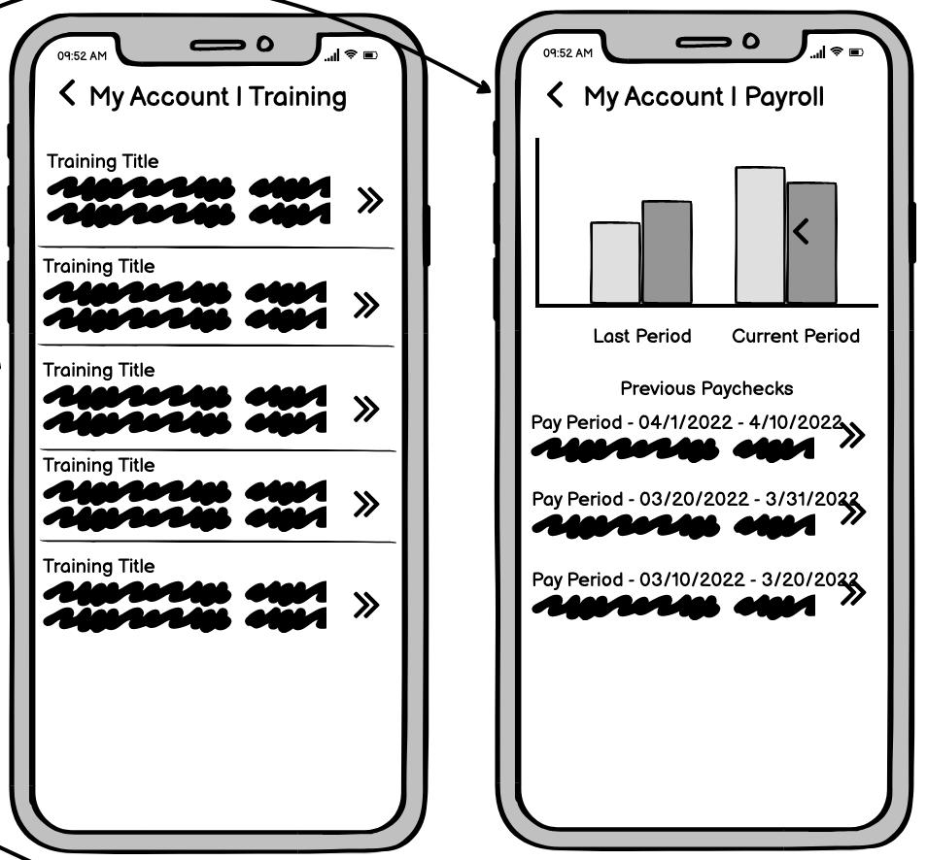
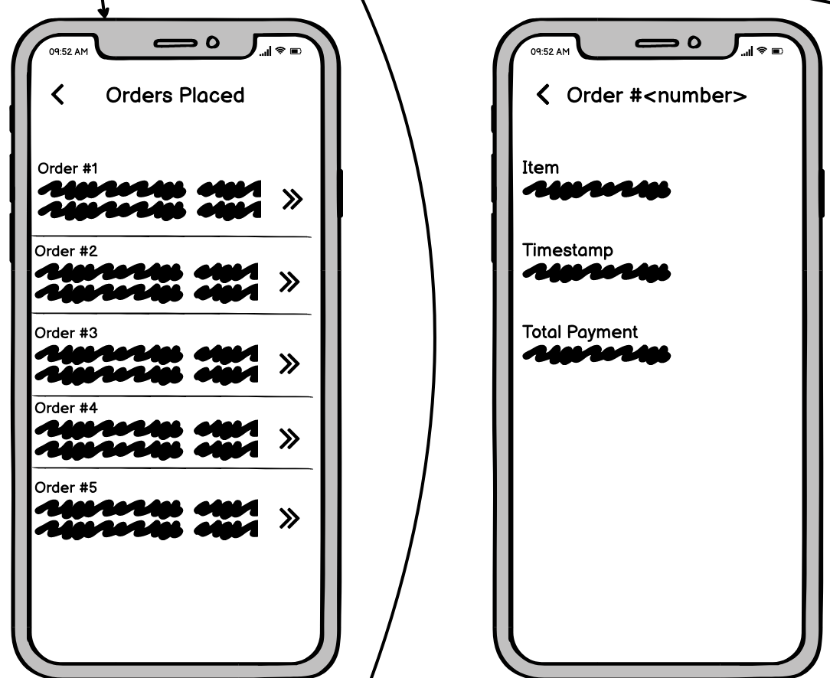
Most Appealing Features | Employee

Slide 7
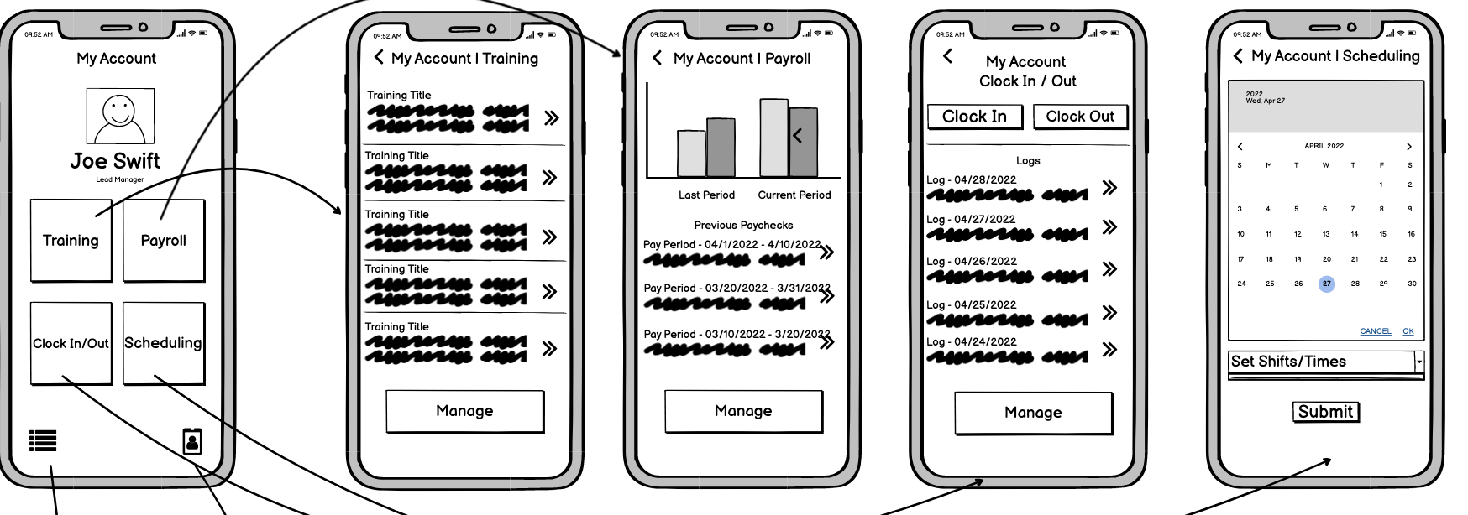
Most Appealing Features | Manager

Slide 8
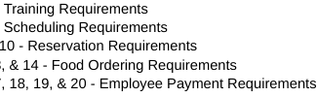
Major Challenges and Their Solutions
Which of our use-cases are logically cohesive?
Who should handle credit card processing?
PCI compliance
Deciding on UI/UX guidelines
Splitting work made UI/UX worse

Slide 9
Lessons Learned / Summary
Clarify Expectations/ Requirements Early and Often
Redundancies when teammates on different pages
When requirements change, everyone needs to know
UI Design is an iterative process
Know Your Limits

Slide 10
Questions?
Github Repo: https://github.com/tmyarow/CS3704_Project

